Slide 1
MAYSUN SOLAR
Make Sun Work For Us，Create A Better Earth

Slide 2
01
Maysun solar
Company Profile
02
Main Products
03
Quality assurance
04
Sales Network
05
Projects
Maysun
solar

Slide 3
01
PART
Company Profile
Notes:
模板来自于 http://meihua.docer.com/

Slide 4
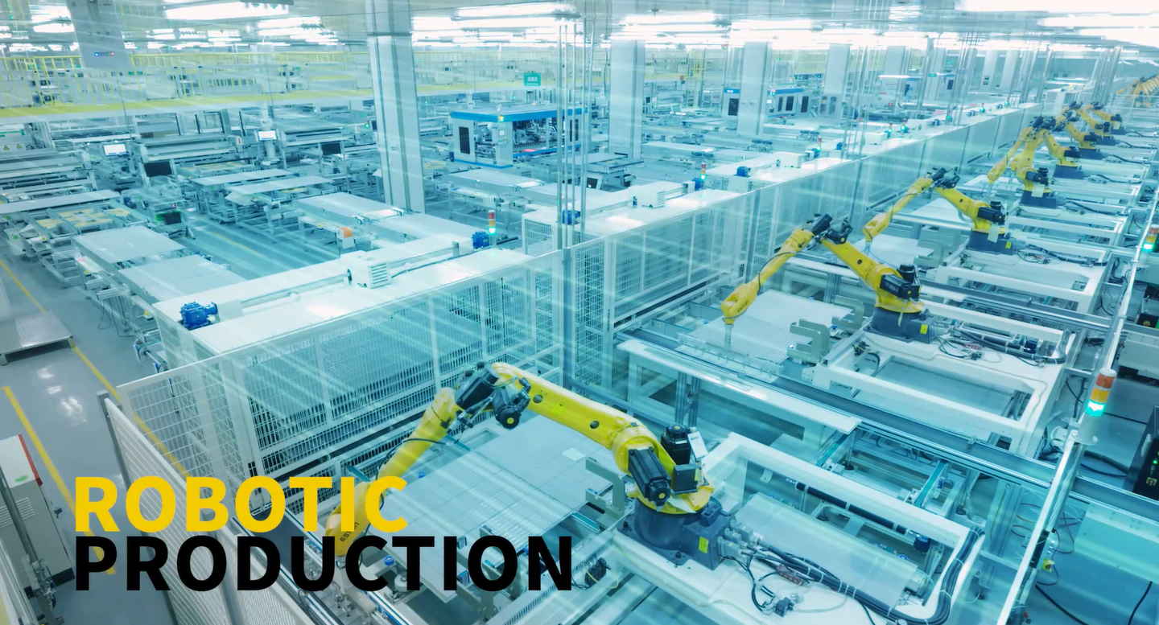
01 Company Profile
Established in 2008,our headquarter is located in Hangzhou,China. As a professional solar modules manufacturer and seller, We own two production bases in China and UAE. With 1GW production capacity per year and annual sales more than 100 million US dollars .
Our production lines are compatible with the most advanced 218mm cell technology in the photovoltaic industry, we export to more than 80 countries and regions worldwide, and we set multiple overseas sales offices to facilitate fast delivery and after-sales service.
maysun solar

Slide 5
HEADQUARTER
FACTORY
OFFICE
添加标题
添加标题
GH SOLAR
Pakistan
Sales Office
Indonesia
Sales Office
MAYSUN SOLAR
Factory
Poland
Sales Office
Nertherland
Sales Office
2008
2010
2012
2015
2016
2021
2009
2011
2012
2016
2017
GH SOLAR
Factory
Dubai
Sales Office
Saudi Arabia
Sales Office
Hungary
Sales Office
Germany/Italy
Sales Office

Slide 6
Advanced Technology
MBB Half- Cell
Bifacial
Double Glass
Shingled
N-Type Topcon
N-Type HJT
IBC

Slide 7
02
PART
MAIN PRODUCTS
VenuSun: Full-black PV modules 390W-410W
TwiSun: Mono Double Glass 390W -410W
Mono 210cells 350W-670W
Mono 182cells 390W-550W
Mono 166cells 360W-490W
Mono Shingled 350W-490W
Notes:
模板来自于 http://meihua.docer.com/

Slide 8
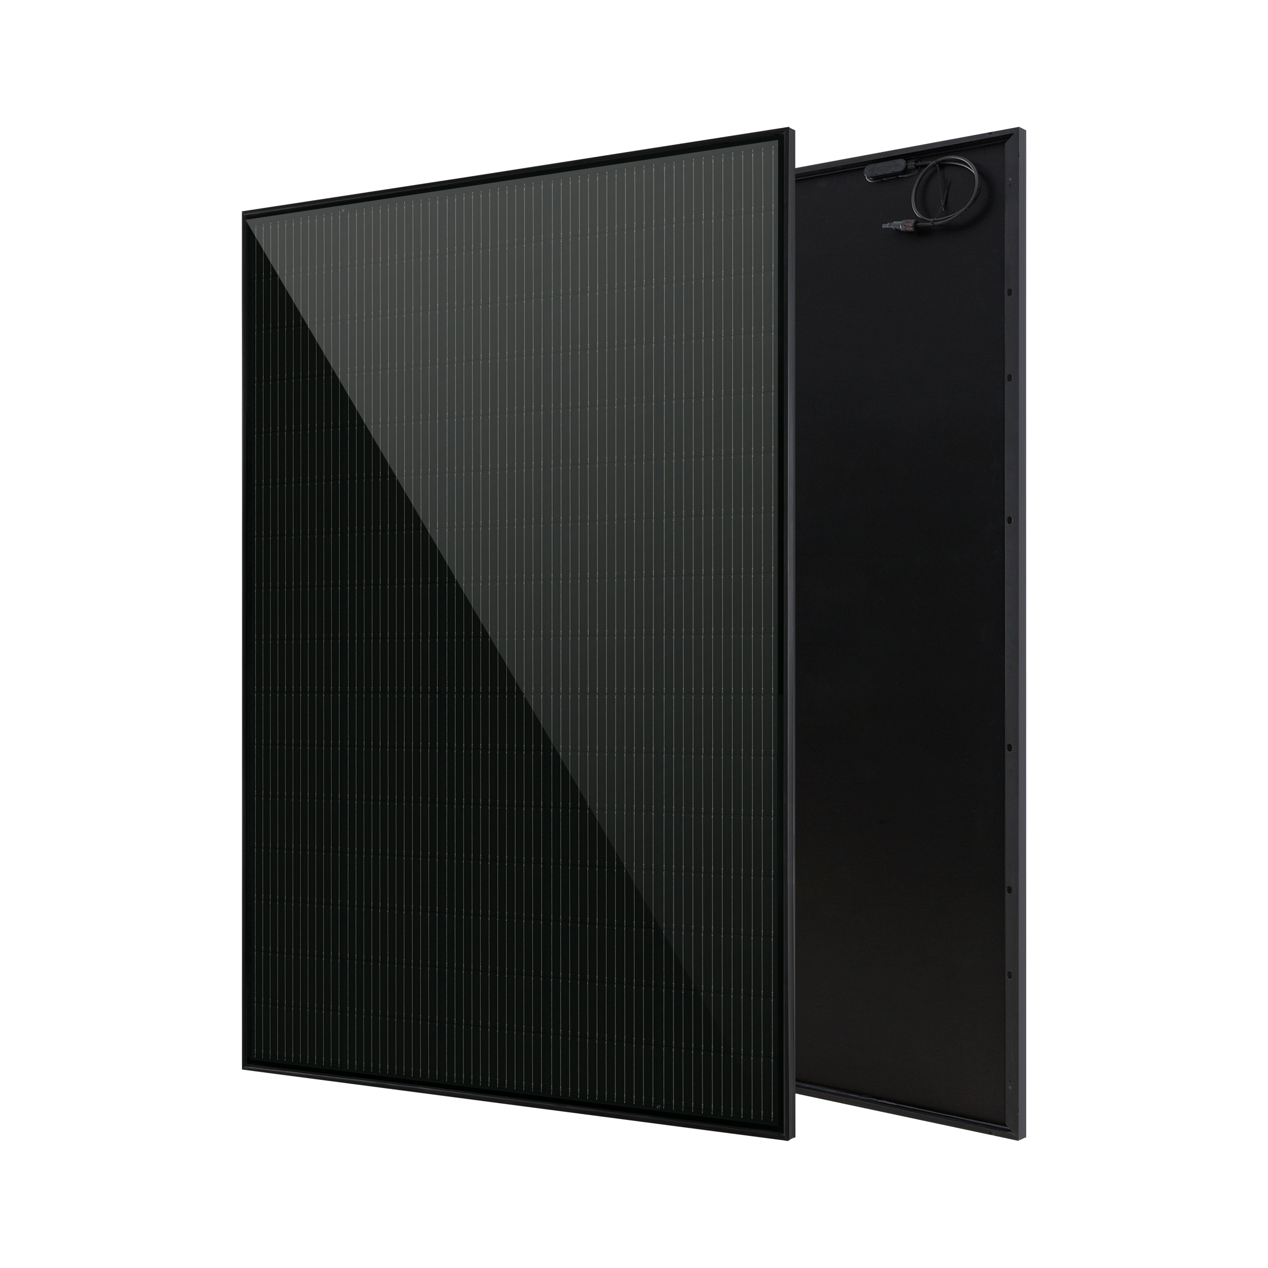
VenuSun: Full-black PV modules 390W-410W
01
410W
New layout design, compact and uniform overall layout, and perfect dimensions & weight can save installation space and transport cost.
02
Hidden black bus-bars, very elegant and beautiful appearance of all black components, and the perfect combination of building style, melting ice and snow faster in winter.
03
The most advanced large-size 210mm cell and PERC+SE technology have higher conversion efficiency and save installation cost.
04
Reliable MBB+ half-cut technology can effectively reduce power mismatching caused by shadow occlusion.
05
Highly automated production equipment, stable production process, 25-year performance guarantee.
06
70cm cable，no need to add extension cables for horizontal and vertical installation.
VenuSun

Slide 9
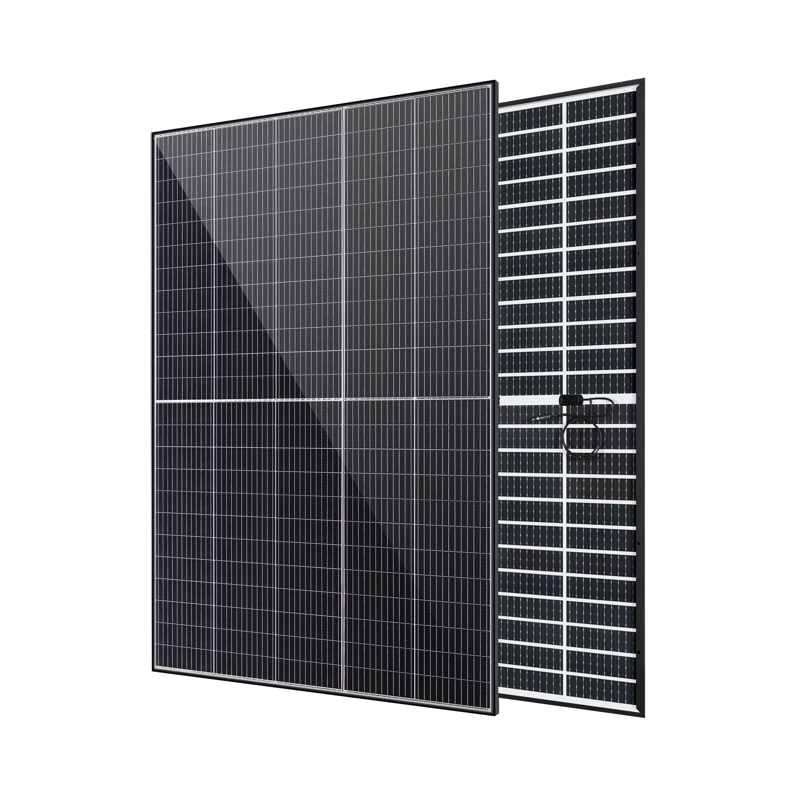
TwiSun: Lightweight Double Glass 390W-410W
410W
01
1.6mm ultra-thin dual-glass technology, tailored for distribution, weighs 19.5KG and makes it easier to construct and install the system.
02
Widely used in various environments, such as high temperature, high humidity, high cold, acid rain, salt spray, ammonia, etc. The service life exceeds 30 years.
03
Double glass offers greater fire safety and can be installed 0.5 metres apart from neighbours (Germany), making it more suitable for high-density residential areas.
04
Based on 210mm wafers and 1/3-cut cell technology, low current, high efficiency, adaptable to all European inverters.
05
Bifacial power generation technology for additional backside gain and 5%-30% increase in power generation in different application environments.
TwiSun
Notes:
https://www.ypppt.com/https://www.ypppt.com/

Slide 10
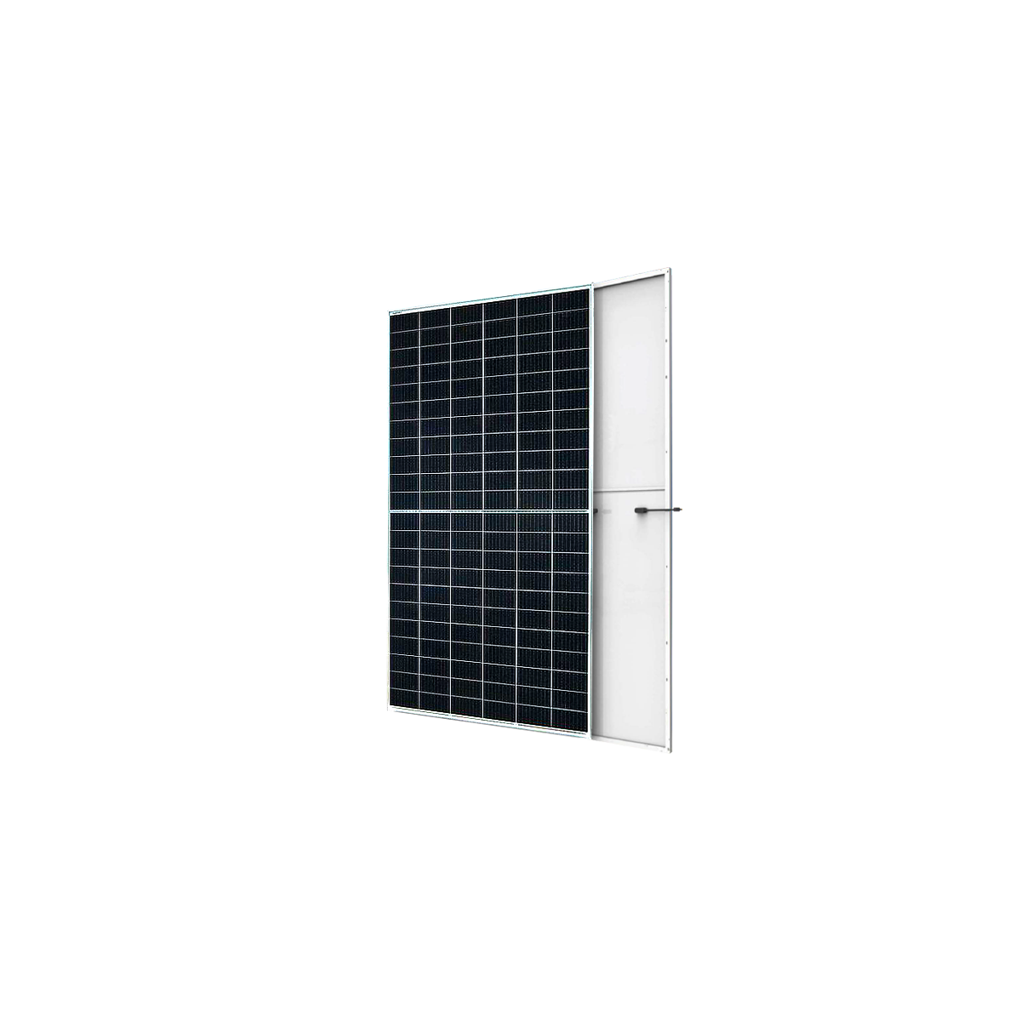
Mono 210cells 400W-670W
670W
Reasonable component size design and large packing quantity, saving transportation and installation cost.
The large-size cell adopts non-destructive cutting to reduce defects.
Multi-busbar wire welding technology, lower resistance, more averaged current density.
Low hot spot design reduces the risk of hot spots.
High-quality raw materials ensure long component life.

Slide 11
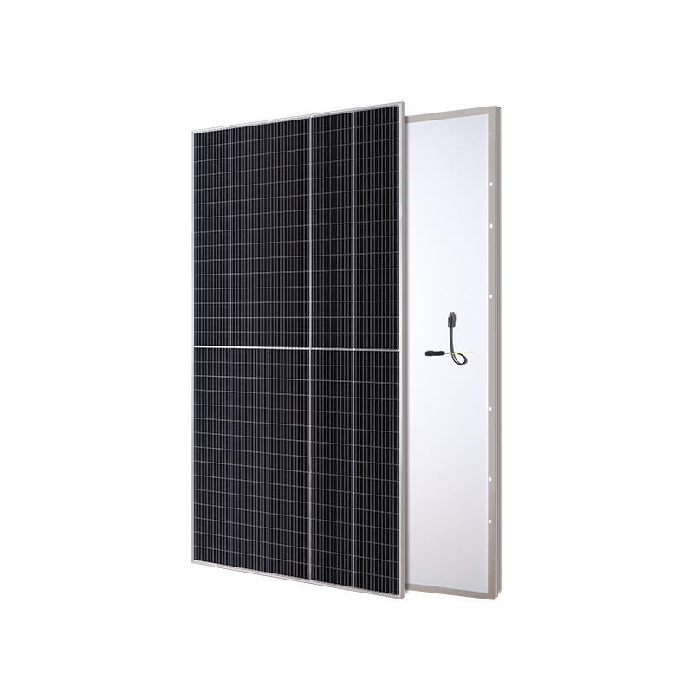
Mono 182cells 390W-550W
540W
Large-size and high-power components save more transportation and installation costs.
Excellent low-light performance, power output even in cloudy days.
Half-Cell technology reduces the risk of hot spots.
The new solar cell technology has a better low temperature coefficient.
Better light utilization and current collection capabilities, effectively improving product power output and reliability.

Slide 12
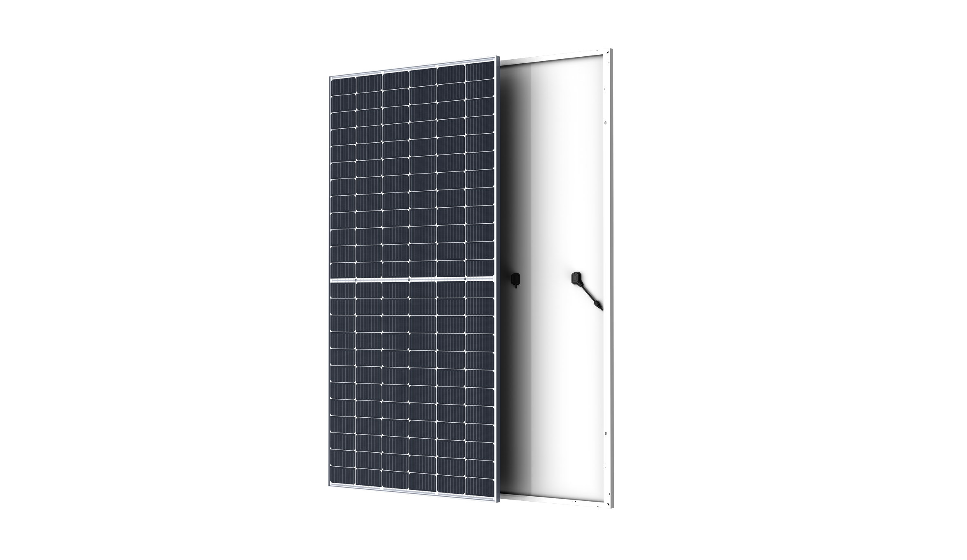
Mono 166cells 370W-460W
450W
Mature technology for complex installations in residential systems
Continuously improved cell technology reduces the cost of modules
Half-cell process effectively reduces power mismatching of shadow
Stable module quality ， protects customers’profit effectively
Excellent anti-PID performance reduces power degradation
N-Type

Slide 13
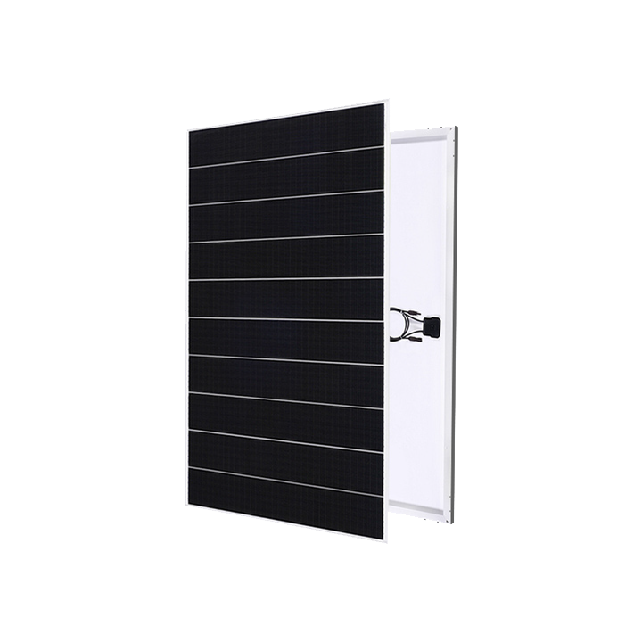
Mono Shingled 350W-490W
410W
01
Innovative structure, low temperature bonding, high density layout, better aesthetics
02
Safe and reliable, no hidden cracks in the welding seams, low working temperature, high pressure resistance
03
Low system cost and high efficiency of components reduce system cost
04
Low shading loss and full parallel circuit layout bring more effective power generation
05
Intelligent and advanced production equipment and excellent production process quality control, guarantee high output efficiency
Notes:
https://www.ypppt.com/https://www.ypppt.com/

Slide 14
03
PART
QUALITY ASSURANCE
15-year product warranty
25-year product performance guarantee:
First year power generation ≥97.5%
25-year power generation ≥85.5%
https://www.maysunsolar.com/services/
Notes:
模板来自于 http://meihua.docer.com/

Slide 15
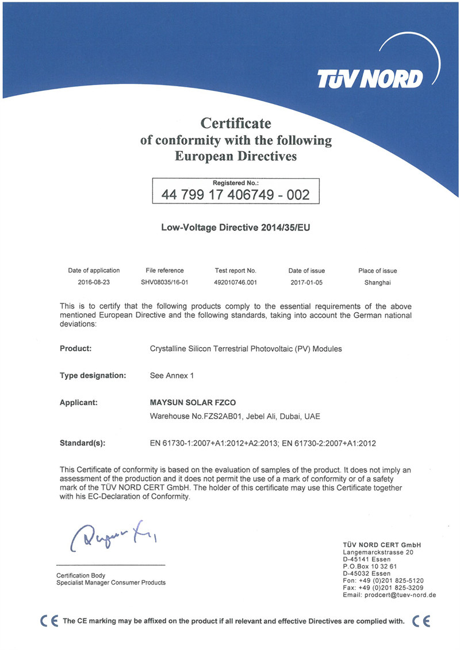
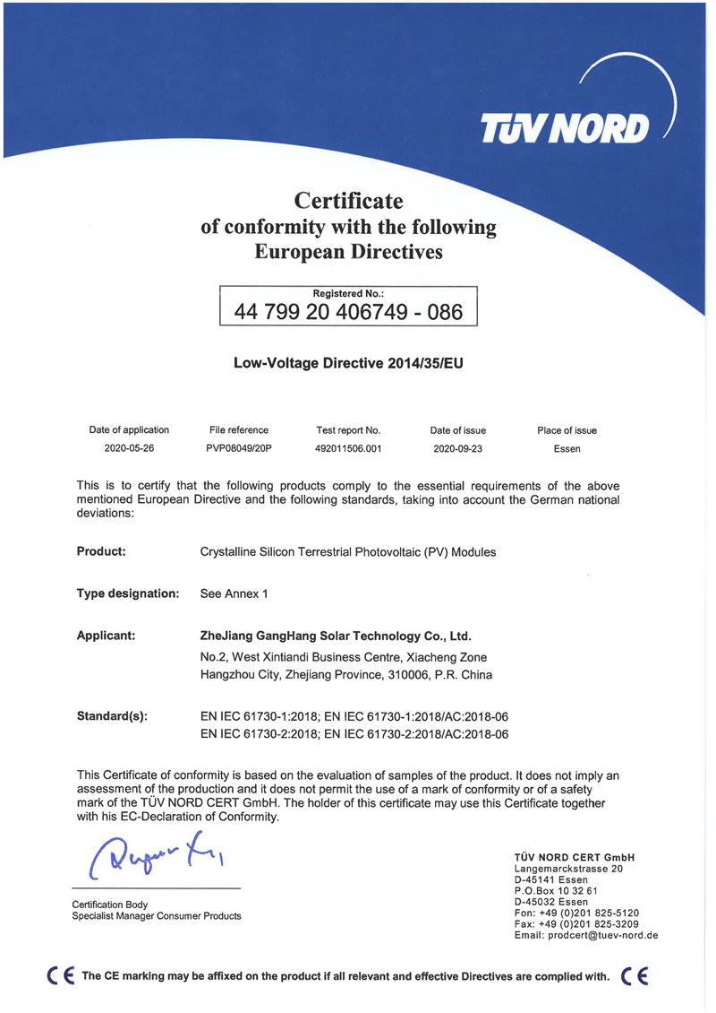
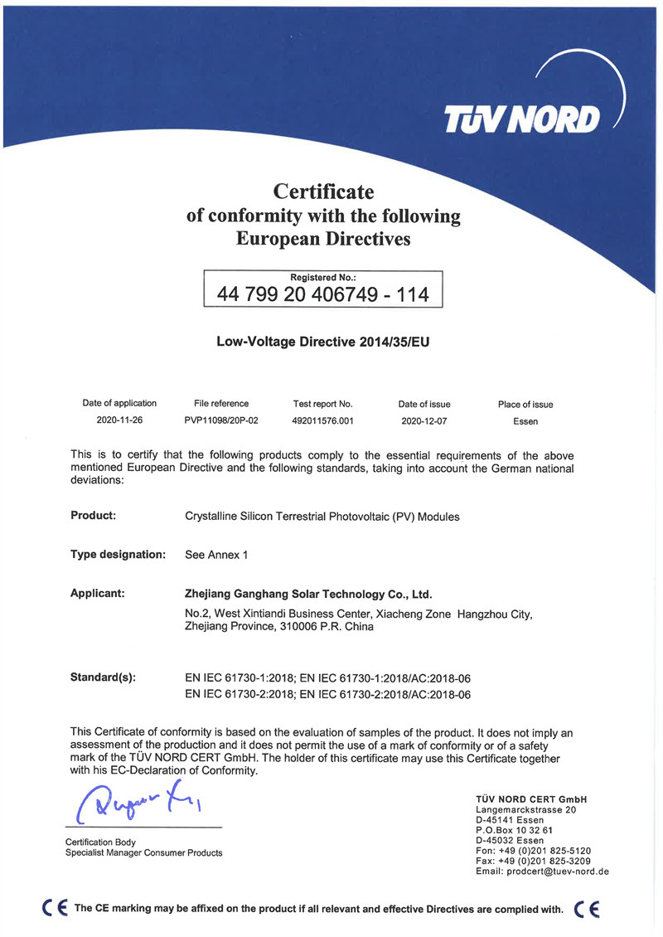
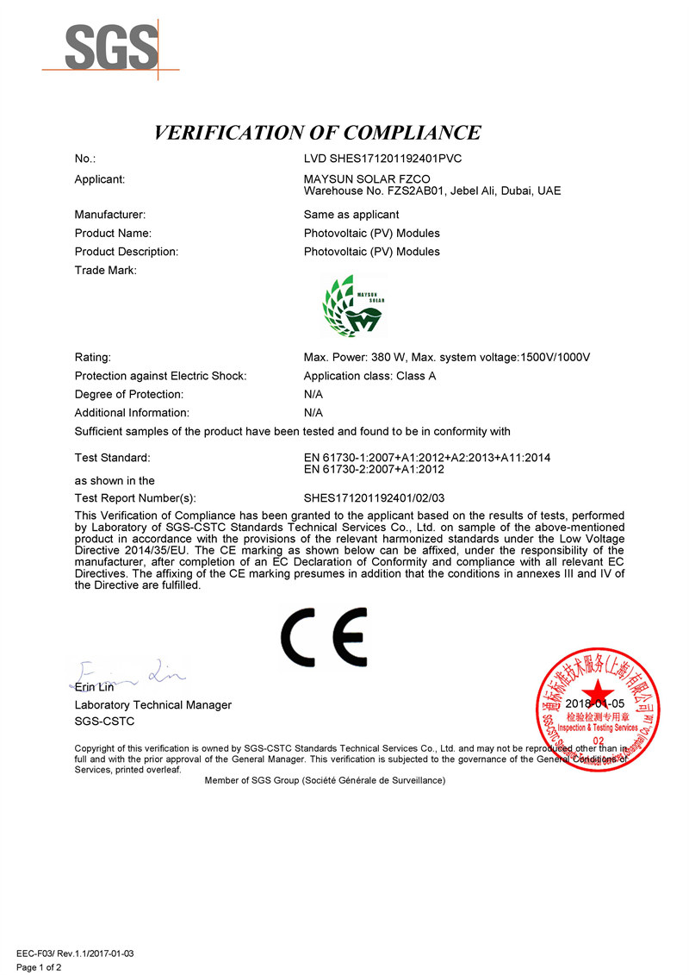
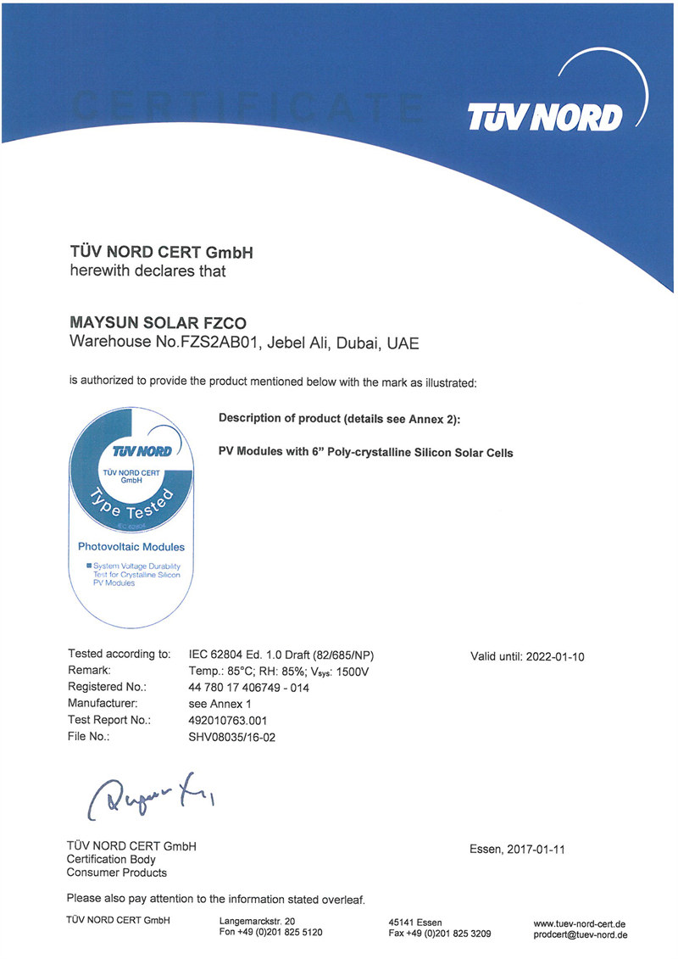
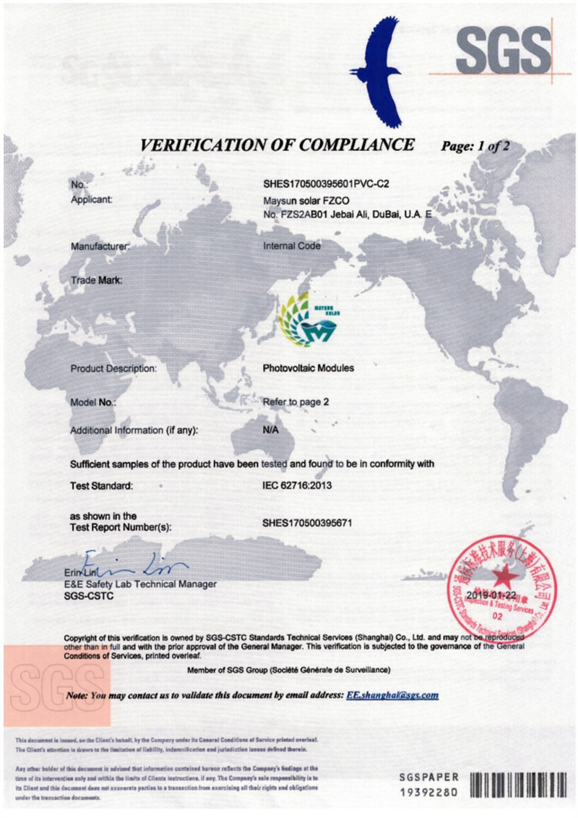
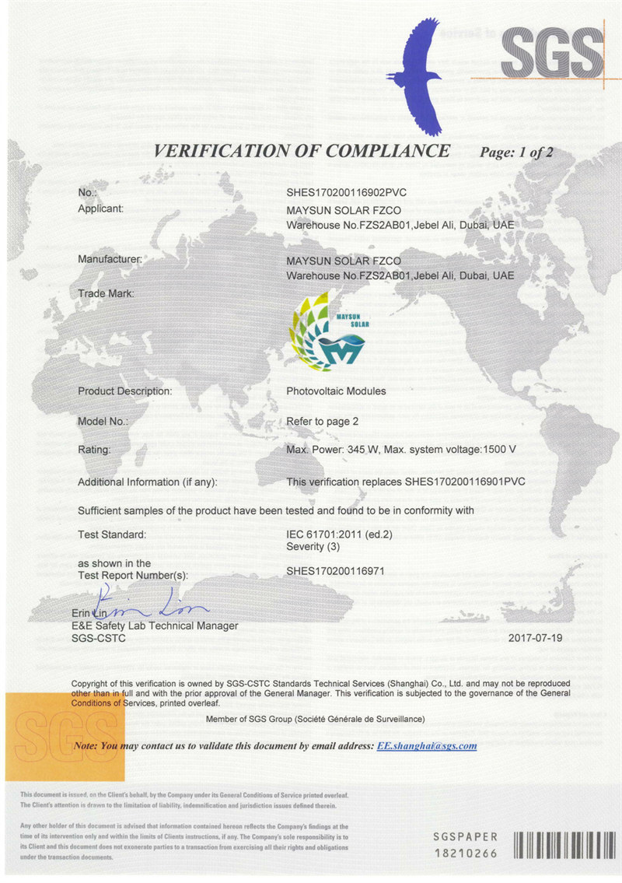
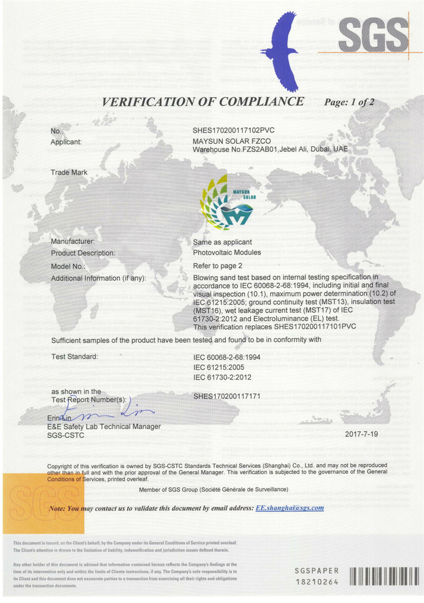
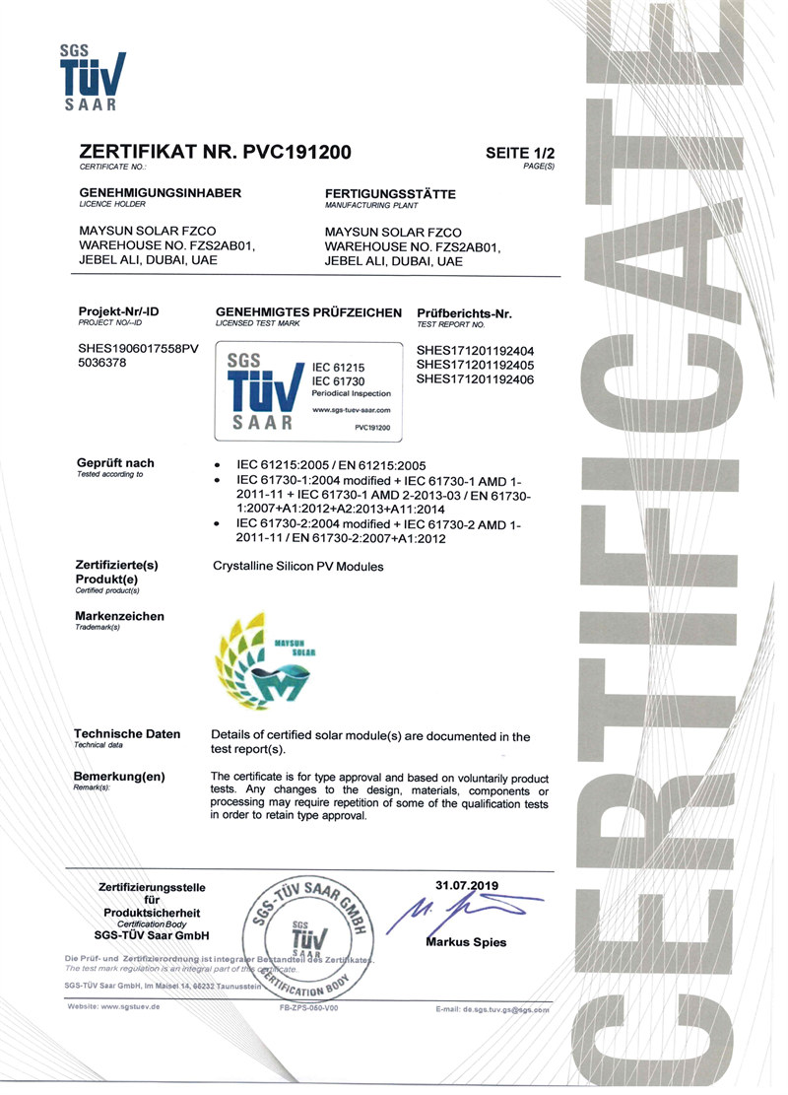
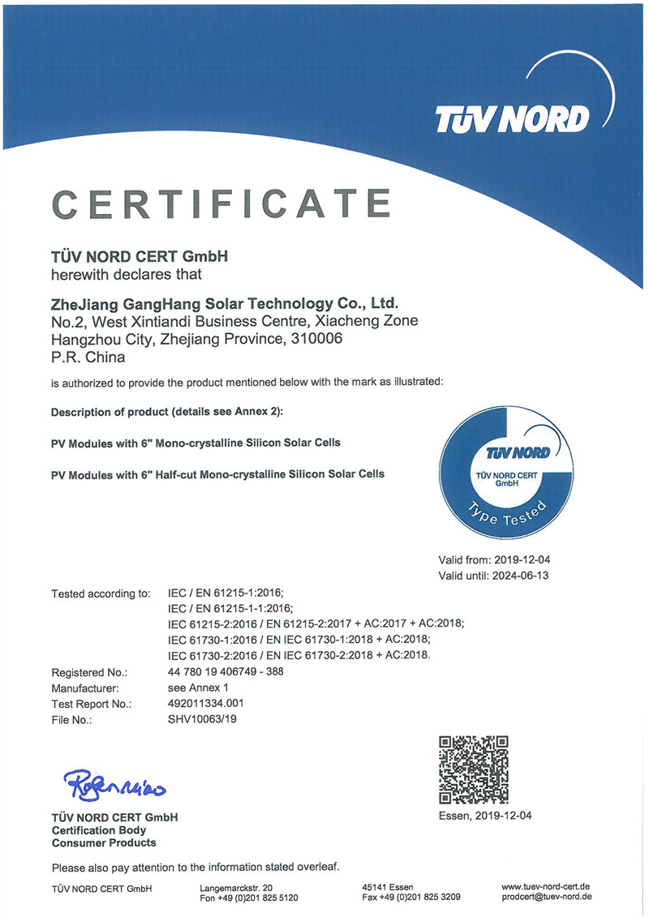
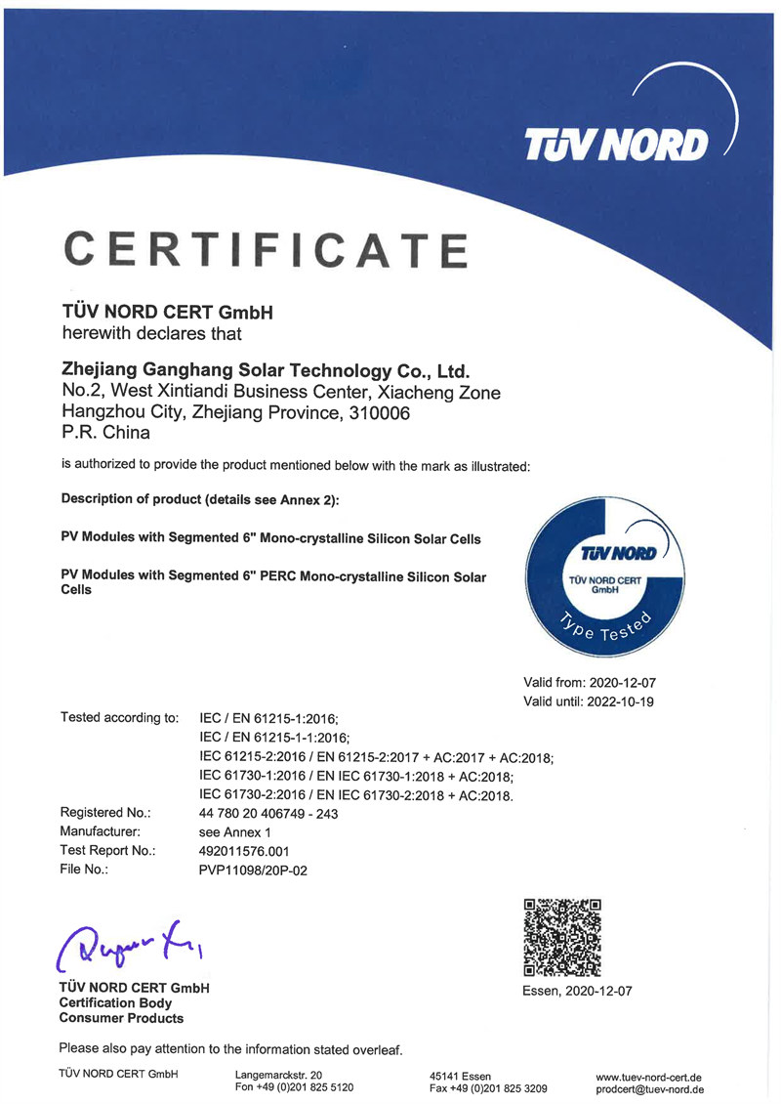
https://www.maysunsolar.eu/download-certificate

Slide 16
04
PART
SALES NETWORK
Found Maysun Solar in
Facebook,Instagram,Twitter,Youtube
LinkedIn
Notes:
模板来自于 http://meihua.docer.com/

Slide 17
Netherlands
Germany
Poland
Hungary
Italy

Slide 18
05
PART
PROJECTS
Notes:
模板来自于 http://meihua.docer.com/

Slide 19
Budapest Hungary
58MW
May 2020
ground power station

Slide 20
Milan Italy
128KW
June 2021
roof solar power station

Slide 21
Warsaw Poland
8MW
April 2019
ground power station

Slide 22
Szombathely, Hungary
150KW
August 2021
on-grid solar power station

Slide 23
Thanks for watching

